Slide 1
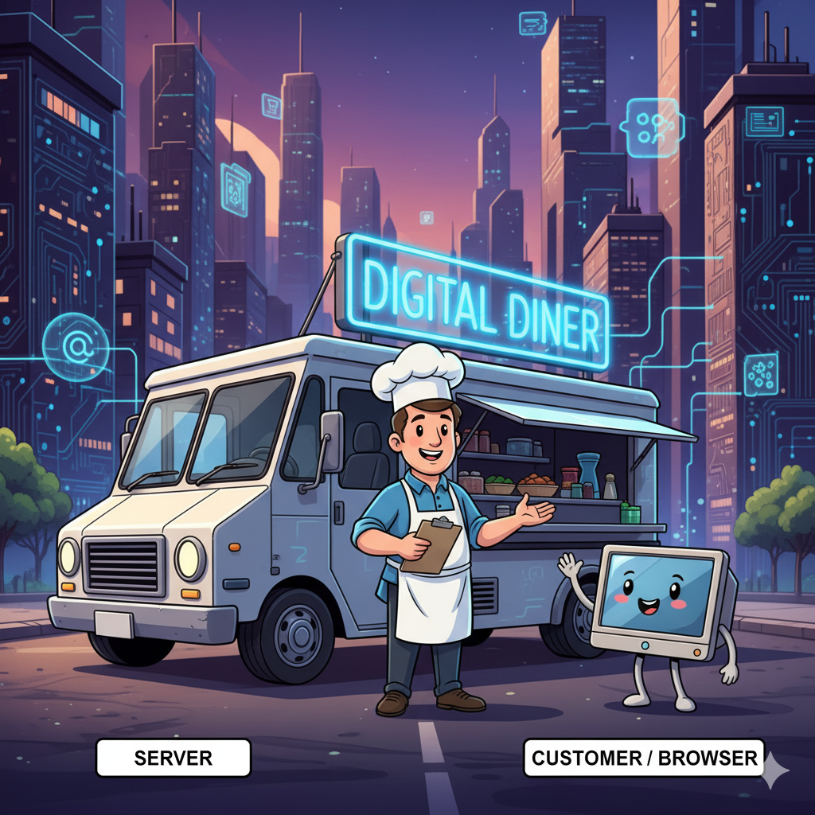
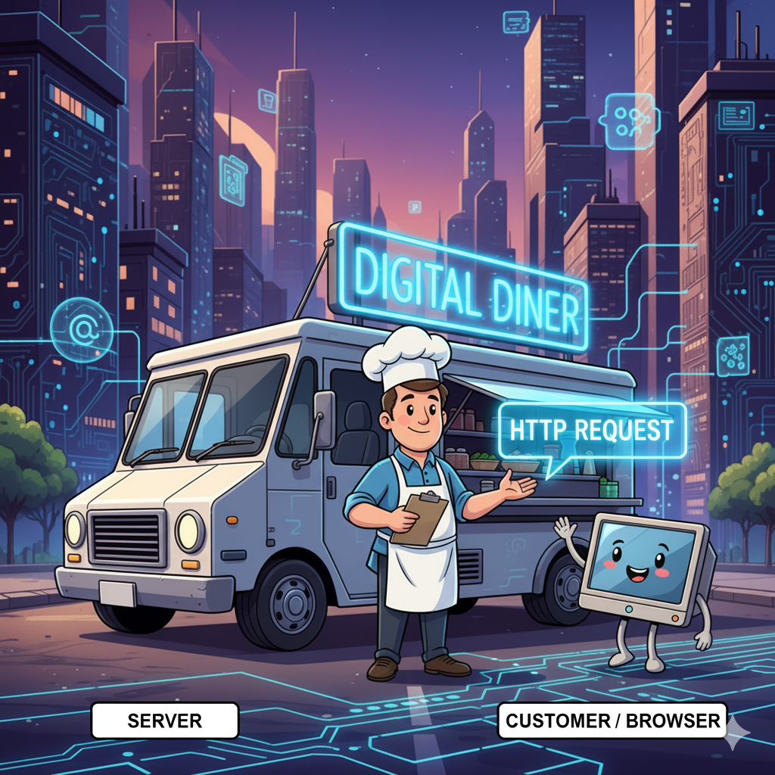
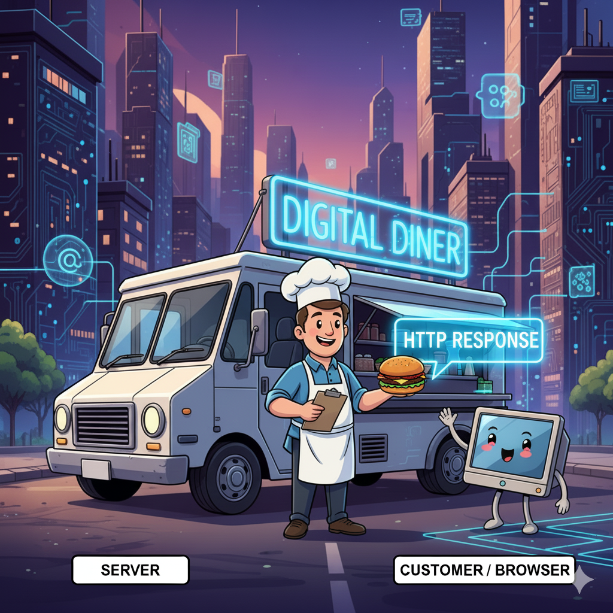
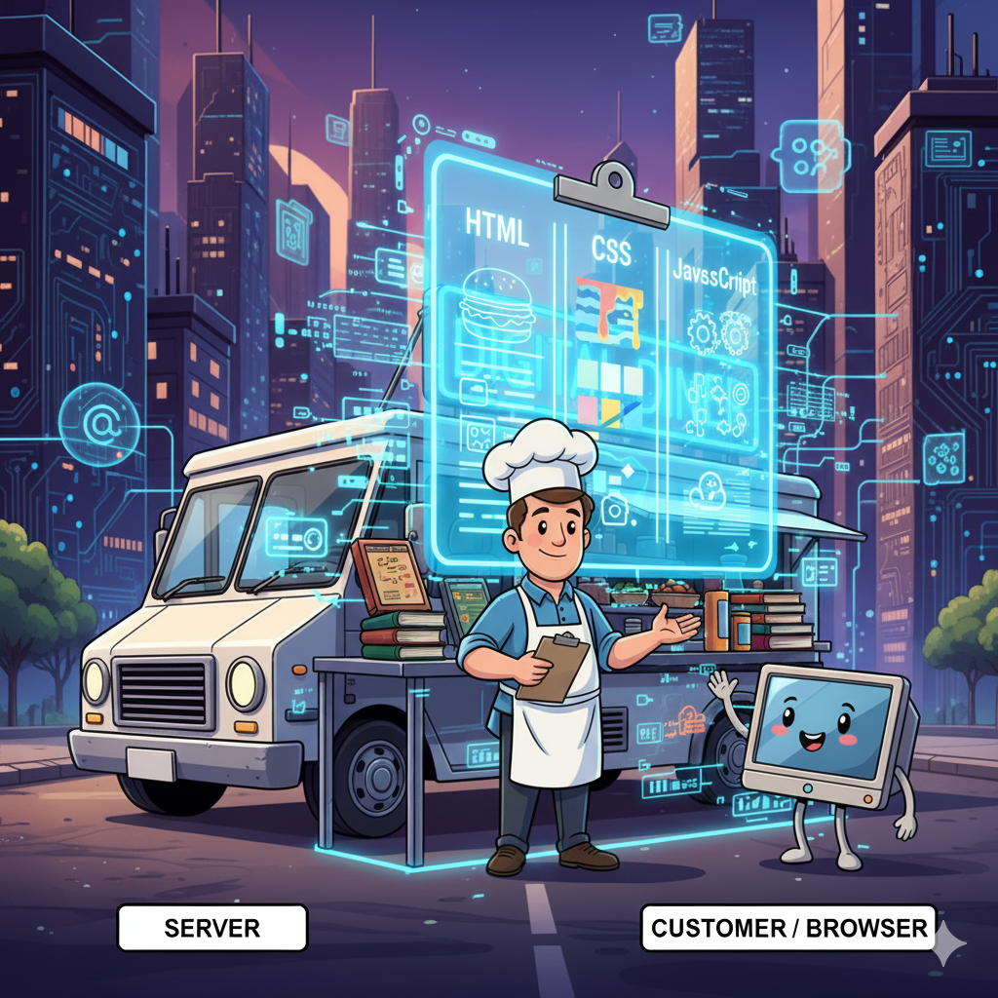
How the Web works.
Think of the internet as a bustling city, and our website as a new food truck called the 'Digital Diner’.
The key players are simple: The client/customer, are the web browsers. The food truck is our server. And the delicious meals we serve are the websites you see.
A customer—that's a user's web browser—decides they want a meal. They type in our diner's address (the URL) and hit 'enter. That's their order, an HTTP/HTTPS Request.
The server receives the order and starts preparing the meal using 3 core ingredients HTML, CSS and JavaScript. This is where our core web development skills come in.
HTML is the structure—It gives the meal its shape
CSS is the style—It makes the meal look good
JavaScript is the magic—it's the interactive part of the website. It's what makes the meal come alive.".
Once the meal is perfectly assembled with all three ingredients, the chef hands it back out the window. This is the HTTP Response.

Slide 2
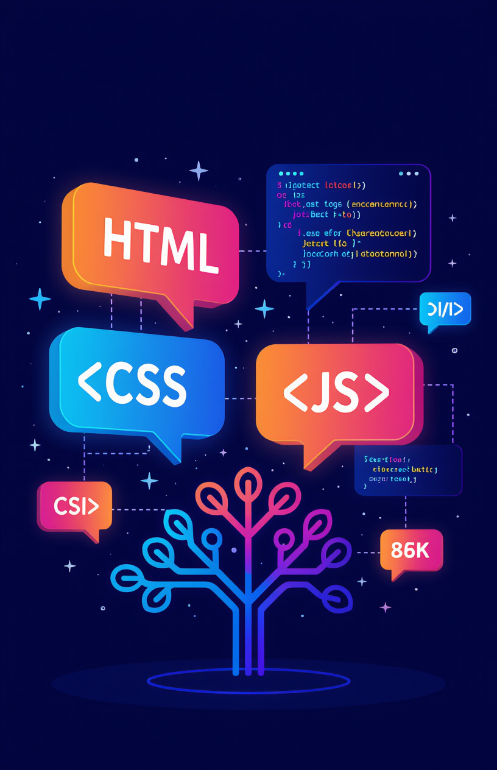
Essential Skills for Web Developers
Fundamental Skills: To become a web developer, several key skills are essential:
HTML (Hypertext Markup Language): The structure and content of web pages.
CSS (Cascading Style Sheets): The visual presentation and styling of web pages.
JavaScript: Adds interactivity and dynamic behaviour to web pages.
Version Control Systems:
Git: A distributed version control system for tracking changes in code. Essential for collaboration and managing code efficiently.
These skills form the foundation for building modern, interactive websites and web applications.

Slide 3

A day in the life of a Web Developer
A web developer's day isn't just about sitting and coding. It's a dynamic mix of creation, problem-solving, and collaboration."
In the morning,
you start with your favourite beverage and tackle the day's tasks, which usually involve writing new code or adding features."
The afternoon
is often about teamwork. You might attend a meeting to discuss a new project, collaborate with a designer on a website's look, or help a colleague fix a tricky bug. This is where communication skills are just as important as coding skills."
The evening
is for reviewing your work, pushing it to the repository (like GitHub), and maybe catching up on a new technology. Then, it's time to unwind and recharge for the next day of building amazing things.

Slide 4

My motivation for Learning Web Development
Personal Insights
My motivation for choosing web development stems from the desire to create digital solutions that users all over the world will love and solve problems. The ability to bring ideas to life through code is incredibly rewarding.
Creativity and Problem-Solving
Web development is a blend of creativity and logical thinking. Each project presents unique challenges that require innovative solutions.
The Joy of Building
As a Technical Support Engineer supporting enterprise applications all my career. The immense satisfaction in seeing a functional website come to life, knowing that I built it from the ground up.

